Slide 1
Protoype
Proxy Settings
Oscar Galindo

Slide 2

Network Traffic Proxy
File
View
Help
Stop
Filter (text box)
…
Save all…
No.
Source
Destination
Protocol
1
Source-name
Destination-name
TCP
Hooks
2
Source-name
Destination-name
TCP
3
Source-name
Destination-name
TCP
Proxy Configuration
4
Source-name
Destination-name
TCP
5
Source-name
Destination-name
TCP
6
Source-name
Destination-name
TCP
7
Source-name
Destination-name
TCP
8
Source-name
Destination-name
TCP
9
Source-name
Destination-name
TCP
10
Source-name
Destination-name
TCP
Packet info
Save
Edit
Drop
Send

Slide 3
Proxy Rules
Modification of packet communication rules.
▼
▼
▼
Rule
Protocol
Port
▼
Chain
[Source IP Address]
[Destination IP Address]
Command Line
Input
▼
Forward
Output
▼
Add
OK
Delete

Slide 4
Proxy Rules
Modification of packet communication rules.
▼
▼
▼
Block Communication
All
2500
▼
Output
xxx.xxx.xxx.xx:xxxx
129.126.132.1
Command Line
Input
▼
Forward
Output
▼
Add
OK
Delete

Slide 5
Proxy Rules
Modification of packet communication rules.
▼
▼
▼
Rule
Protocol
Port
▼
Chain
xxx.xxx.xxx.xx:xxxx
129.126.132.1
Command Line
Input
▼
Forward
Output
Block Communication | Destination: 129.126.132.1| Protocol: All| Port: 2500
▼
Add
OK
Delete

Slide 6
Proxy Rules
Modification of packet communication rules.
▼
▼
▼
Rule
Protocol
Port
▼
Chain
xxx.xxx.xxx.xx:xxxx
129.126.132.1
Command Line
Input
▼
Forward
Output
Block Communication | Destination: 129.126.132.1| Protocol: All| Port: 2500
▼
Add
OK
Delete

Slide 7
Proxy Rules
Modification of packet communication rules.
▼
▼
▼
Rule
Protocol
Port
▼
Chain
xxx.xxx.xxx.xx:xxxx
129.126.132.1
Command Line
Input
▼
Forward
Output
▼
Add
OK
Delete

Slide 8
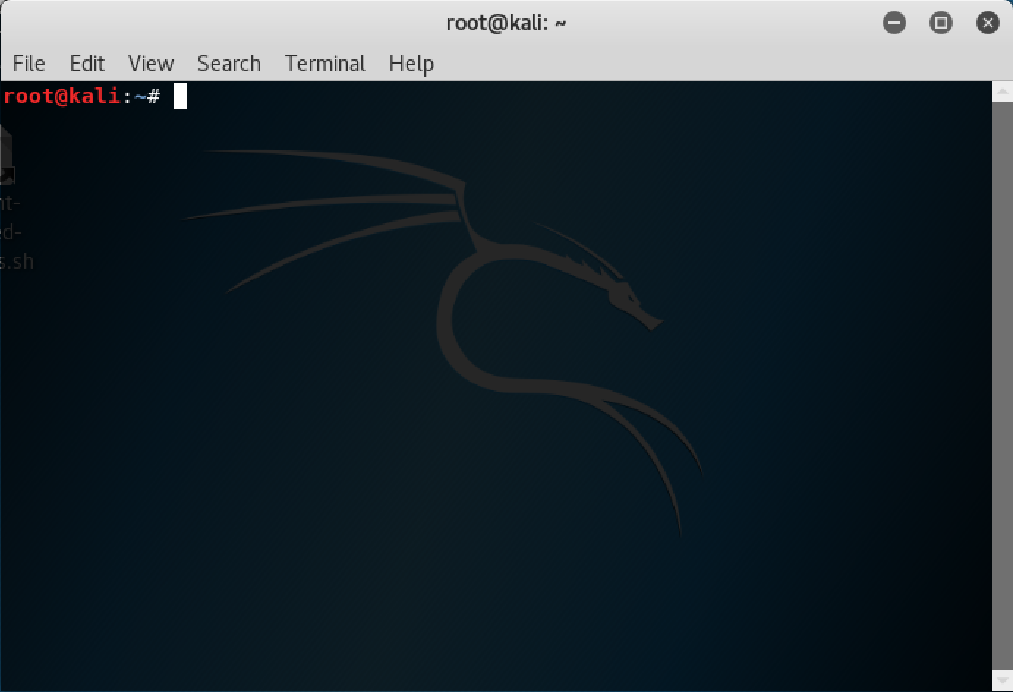

Slide 9
Proxy Rules
Modification of packet communication rules.
▼
▼
▼
Rule
Protocol
Port
▼
Chain
xxx.xxx.xxx.xx:xxxx
129.126.132.1
Command Line
Input
▼
Forward
Block Communication | Source: 129.126.132.1| Protocol: All| Port: 2500
Output
▼
Add
OK
Delete

